Slide 1
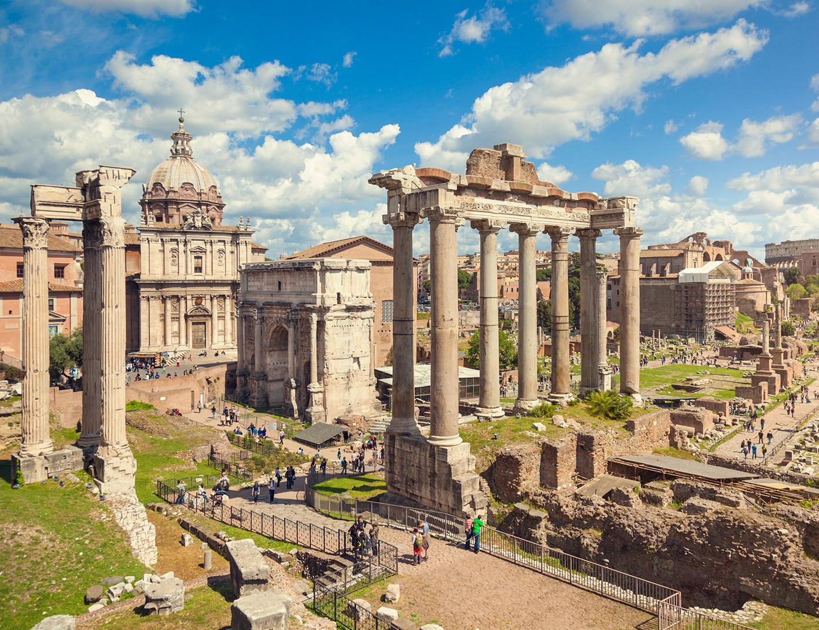
Ancient Rome
- Identify the location of Rome
- Describe Ancient Roman geography
Week 4 Lesson 1
Ms Barrie

Slide 2
Unit 2 – Ancient Rome
Julius Caesar, Rome, 100-44BCE
4 - 5 | Ancient Rome Overview
6 - 10 | Julius Caesar (JC) | WEEK 8: TASK 6 – Test WEEK 10: TASK 7 – Explanation (Essay)
1 – 4 (Term 4) | Historical Inquiry Project Selected Individual | WEEK 1 - 4: TASK 8 – Historical Inquiry Project/Validation

Slide 3
What do you already know about Ancient Rome?
Class discussion

Slide 4
Watch the following video
https://www.youtube.com/watch?v=GXoEpNjgKzg&ab_channel=NationalGeographic

Slide 5

Geography is an integral part of the development of ancient civilizations. Rome is one of history's largest and most powerful civilizations. The Roman Empire ruled across parts of three continents (Europe, Africa, and Asia) for over 1,000 years. Rome began as a small village near the Tiber River on the Italian Peninsula close to the Mediterranean Sea. The city was far enough inland to provide some protection from those at sea but close enough for ease of transportation. Several of the region's key geographical features helped Roman civilization to thrive.

Slide 6
ACTIVITY 1 – Mapping Rome
Use the worksheet provided to shade and label key locations in Ancient Rome by its greatest extent in 177AD

Slide 7
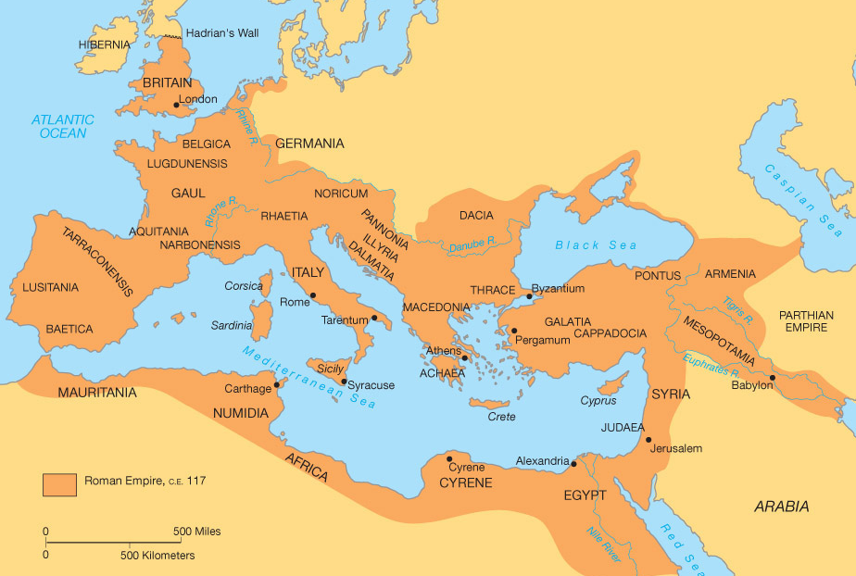

Slide 8
Roman Geography – Tiber River
Summarise in your book
The Tiber River is the second longest river in Italy and was a source of freshwater and rich soil needed to support the development of people, animals, and crops of Rome.
The river begins in the Apennine Mountains and flows to the Tyrrhenian Sea, with Rome located to the east of the river.
The Tiber provided easy transportation and the river’s valley created a large area for farming. The river also served as a defence system against attacks coming from the other side of the river.

Slide 9
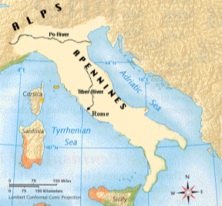

Slide 10
Roman Geography – Mountain Ranges
Summarise in your book
The Alps and Apennine Mountain ranges were natural barriers that helped protect Rome from invasions and provided a strategic location for the city during war time. The Alps provided a roadblock that forced invaders to move through narrow passages, allowing the Romans time to prepare and attack.
The Apennine Mountains divided the peninsula in half, providing protection against invasion from the east. This allowed Rome to defend against invaders approaching from either side of the mountains.
Covered in forest, the hills and mountains are made of volcanic rock. The Romans used this hard and spongy rock to build the foundations for their structures.

Slide 11
Roman Geography – Mediterranean Sea
Summarise in your book
Being close to the Mediterranean Sea allowed Rome to trade with cities in Greece, northern Europe, and North Africa.
The Mediterranean also provided the Romans with a rich source of food through fishing.
Inspired by the Phoenicians' skilled shipbuilding, the Romans copied their designs to build their own ships.

Slide 12
ACTIVITY – Reading Comprehension
Read through the information sheet about Ancient Rome
Answer the following questions in your book:
Identify and label any key dates from the text
What are the BENEFITS of Rome’s location?
Describe the importance of Rome’s waterways
Why are Rome’s roads and bridges so significant?

